Slide 1

Exam AZ-303: Microsoft Azure Architect Technologies Crash Course
Tim Warner

Slide 2


Tim Warner
Based in Nashville, TN, US
MCT, MVP
Twitter: @TechTrainerTim
Badge: TechTrainerTim.com

Slide 3
Day 1 of 2 Agenda
Introduction
Implement and Monitor Azure Infrastructure
Implement Cloud Application

Slide 4
Day 2 of 2 Agenda
Implement Governance and Security Solutions
Implement and Manage Data Platforms
Exam AZ-303 Strategy

Slide 5
Course Materials
timw.info/az303
timw.info/frankenstein

Slide 6
A Different Kind of Training
This is an expert certification, so we will move quickly and assume intermediate-level Azure skills
10-minute break at midpoint
I’m here to answer your questions – take advantage of this!
Use the Q&A panel

Slide 7
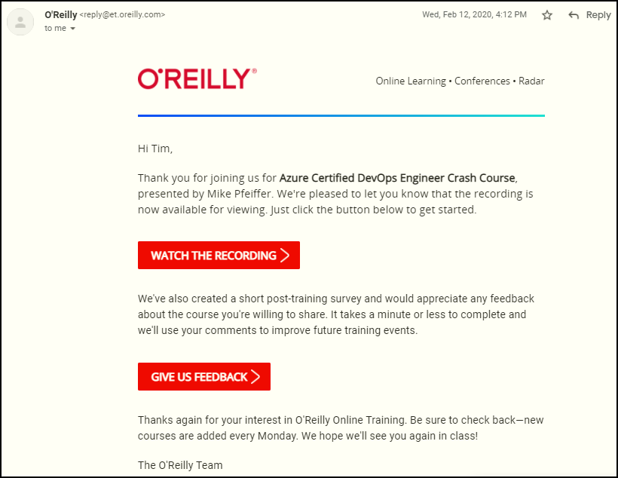
Session Recordings

Slide 8

Session Recordings

Slide 9

Session Recordings

Slide 10


Session Recordings

Slide 11
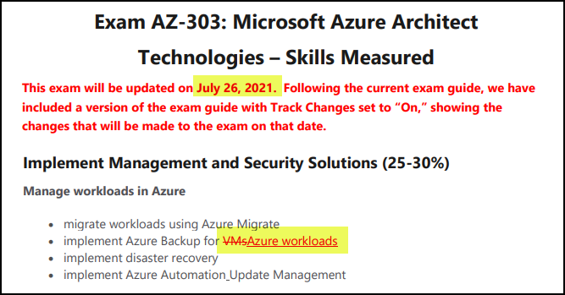
Azure Architect Latest Changes

Slide 12
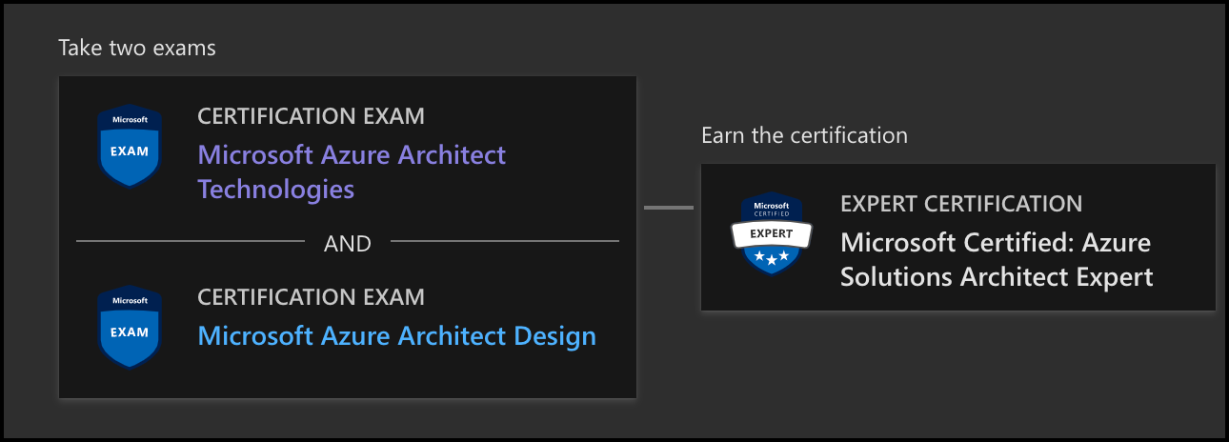
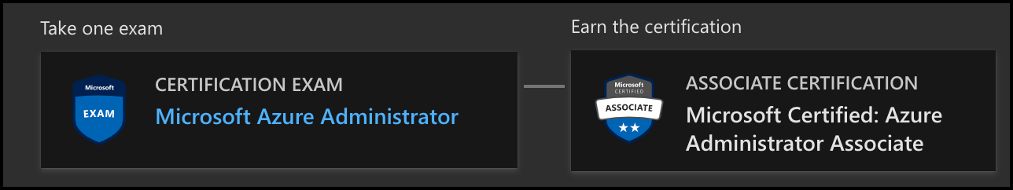
Azure Architect Facts and Tips
AZ-303
AZ-304
AZ-104

Slide 13
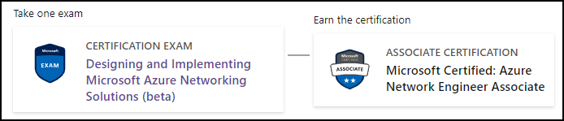
New Azure Networking Certification
AZ-700
AZ-304

Slide 14

Tim's Certification Study Model
Content knowledge
Test-taking skills
Practical application

Slide 15
Thank you!
Course materials: timw.info/az303
Twitter: @TechTrainerTim
Work: timw.info/ps
Web: TechTrainerTim.com

Slide 16
Azure Compute

Slide 17
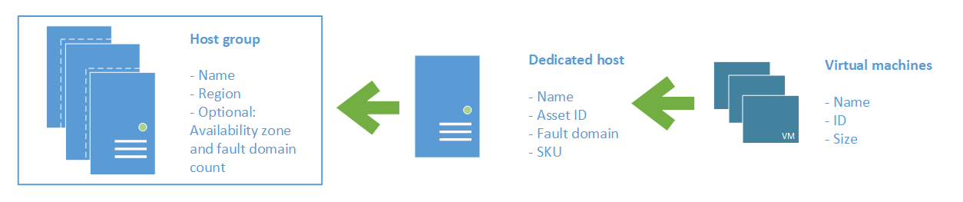
Azure VM Dedicated Host

Slide 18
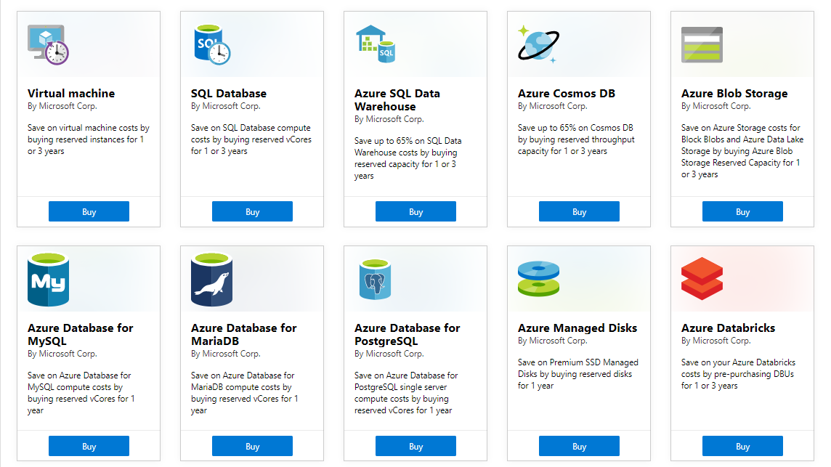
Azure Reservations

Slide 19

VM Scale Sets

Slide 20
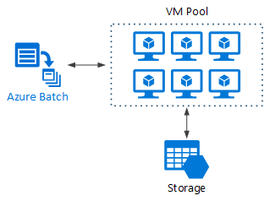
Azure Batch

Slide 21

Availability Set

Slide 22

Availability Zone

Slide 23






Azure App Service
Web Apps
Web Apps for Containers
API Management
Functions
Logic Apps

Slide 24


Docker Lifecycle
https://timw.info/89a04

Slide 25



Running Containers in Azure
Azure Container Instances
Azure Container Registry
Azure Kubernetes Service (AKS)

Slide 26
Load Balancing

Slide 27

VM Networking

Slide 28

Load Balancing

Slide 29

VNet Peering

Slide 30

Hybrid Networking

Slide 31

Network Virtual Appliance

Slide 32

Azure Load Balancer

Slide 33

Application Gateway

Slide 34
Authentication

Slide 35

Azure Subscriptions

Slide 36

Azure Management Scopes
/ Tenant root
Inheritence:
RBAC
Policy
No inheritence:
Tags

Slide 37

Hybrid Identity

Slide 38

Passthrough Authentication

Slide 39

Seamless Single Sign-on

Slide 40
Azure Storage

Slide 41
Storage Account Replication
1
3
3
2
LRS
ZRS

Slide 42
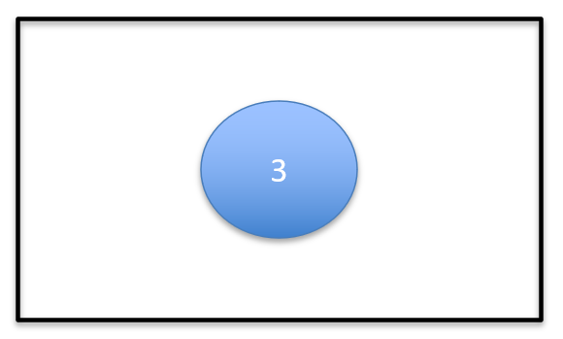
Storage Account Replication
1
3
1
3
2
2
GRS / RA-GRS

Slide 43
Storage Account Replication
1
3
1
3
2
2
GZRS / RA-GZRS

Slide 44

Traffic Manager

Slide 45

Front Door Service

Slide 46
Governance

Slide 47

Tenant vs. Subscription

Slide 48
Azure Management Scopes
/ Tenant Root

Slide 49
App Architecture

Slide 50


Docker Container Lifecycle
https://timw.info/3635f

Slide 51

Event Architecture

Slide 52
Data Platform

Slide 53

Always Encrypted

Slide 54
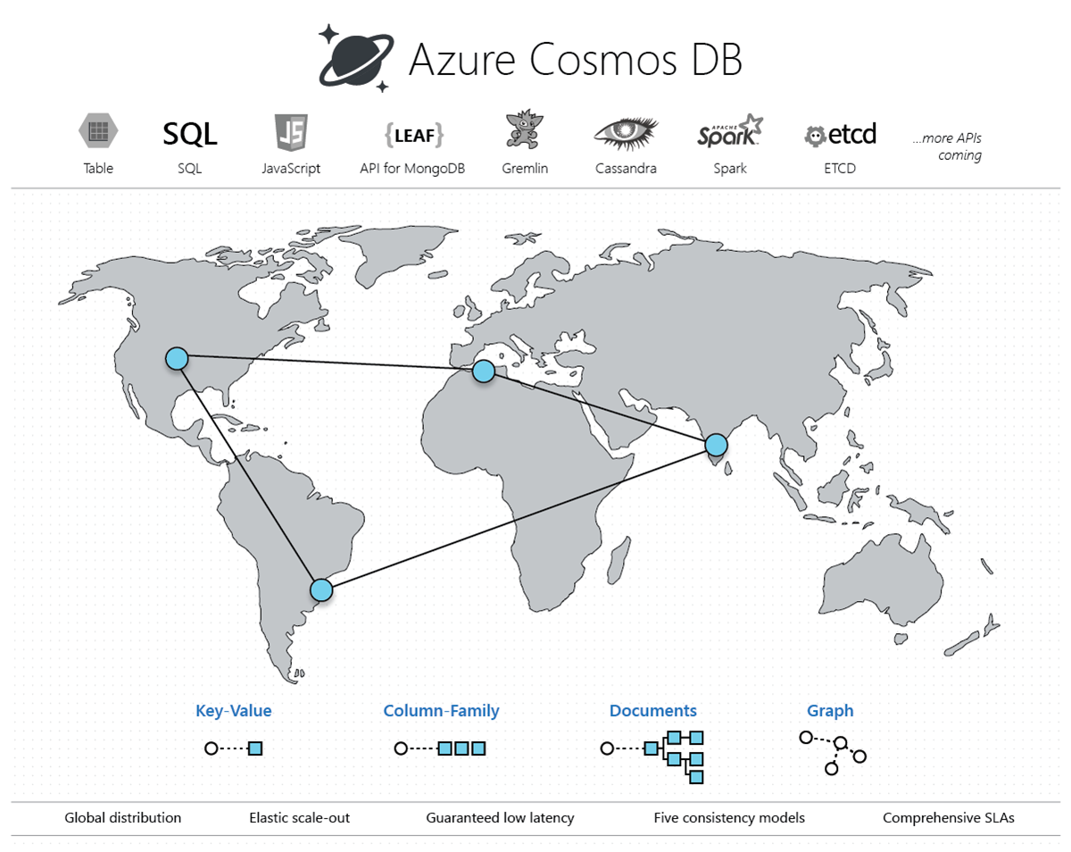
Cosmos DB

Slide 55
Exam AZ-303 Item Types

Slide 56

Multiple Choice

Slide 57

Multiple Choice

Slide 58
Repeated Scenario
You need to move an Azure VM to another hardware host.
Solution: You redeploy the VM.
Does this solution meet the goal?
Yes
No

Slide 59
Repeated Scenario
You need to move an Azure VM to another hardware host.
Solution: You create a proximity placement group.
Does this solution meet the goal?
Yes
No

Slide 60

Select and Place

Slide 61

Build List and Reorder

Slide 62
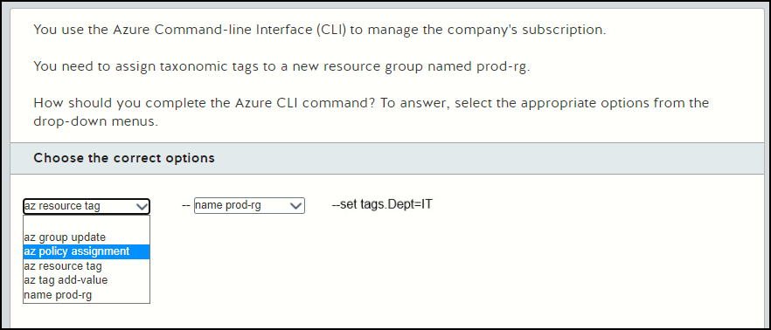
Active Screen

Slide 63

Case Study

Slide 64






Performance-Based Lab

Slide 65
Microsoft Online Testing

Slide 66
Microsoft Online Testing Process
timw.info/online

Slide 67

Microsoft Online Testing Process

Slide 68

Microsoft Online Testing Process

Slide 69

Microsoft Online Testing Process

Slide 70

Microsoft Online Testing Process

Slide 71

Microsoft Online Testing Process

Slide 72

Microsoft Online Testing Process

Slide 73

Microsoft Online Testing Process

Slide 74
AZ-303 Exam Strategy
Focus your skills accordingly:
60 percent Azure portal
20 percent Azure PowerShell
10 percent Azure CLI
10 percent KQL
Expect performance-based labs, but be thankful if you don't see 'em

